Slide 1

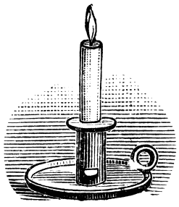
David B. Allison, Ph.D.
“Regression to the Mean – A frequently neglected source of confused conclusion”
Scientist by Nature.
Hoosier by Choice.
allison@iu.edu
Slides Available Upon Request

Slide 2
Disclosures
Dr. Allison has received financial and other benefits from numerous government, non-profit, and for-profit organizations with interests in research, obesity, nutrition, and health, including Am Society of Nutrition; The Obesity Society; Biofortis; Fish & Richardson, P.C.; Frontiers Media; Ikea; Nestle Research Center; The Law Offices of Ronald Marron; Hastings Law Firm, Tomasik, Kotin & Kasserman; University of Miami; University of Alabama at Birmingham.
Acknowledgments
Some slides were inspired by, made in collaboration with, or borrowed from colleagues, and acknowledgments are made throughout. However, the content reflects my thoughts, and not necessarily those of our colleagues or any organization.
Particular thanks to:
Slides and references available upon request: allison@iu.edu.
Angelo Pietrobelli | Cynthia Kroeger | Myles S. Faith
Ashley Skinner | Cynthia Siu | Steven B. Heymsfield
Bernadette de Leon | Daniel L. Smith | Tanya Halliday
Bridget Hannon | Daniella Chusyd | TaShauna Goldsby
Chanaka N. Kahathuduwa | Diana Thomas

Slide 3
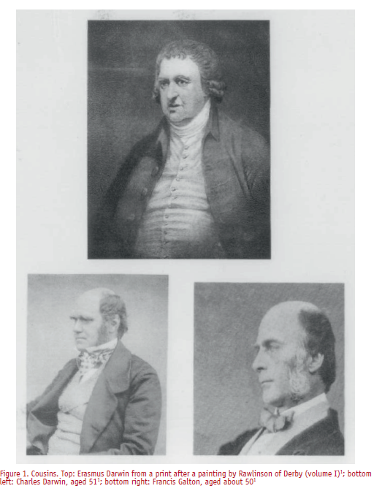
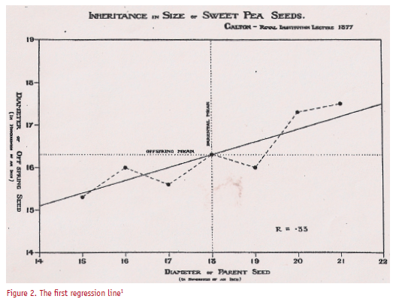
Cousin Francis Helps Charles Solve an Enigma: Why Doesn’t the Phenotypic Variance Increase Each Successive Generation?
From: Gillham, Significance, 2009.

Slide 4
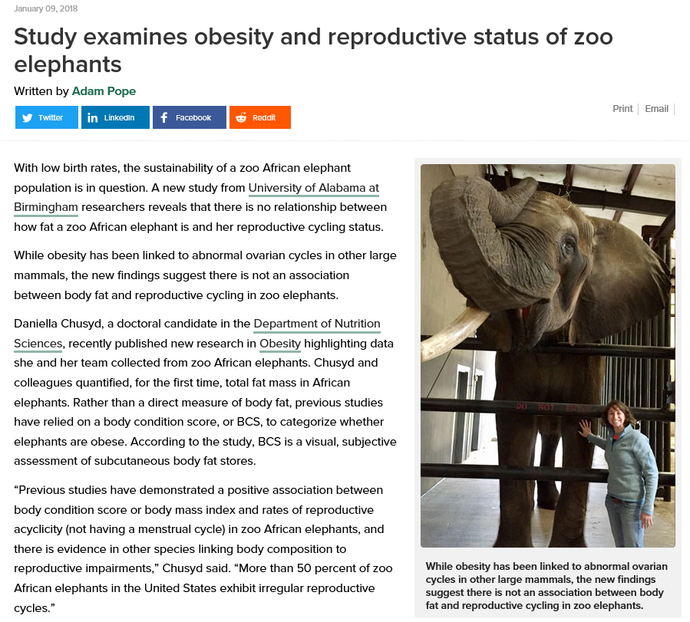
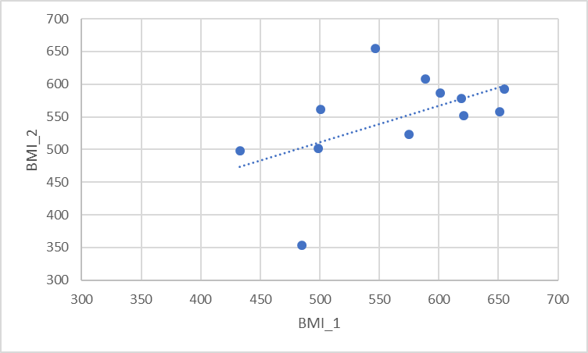
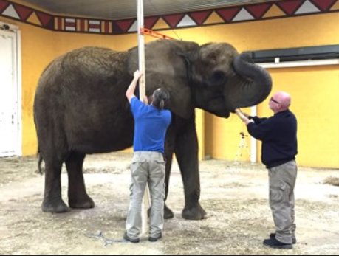
An Elephantine Example
With thanks for the data to:
Daniella Chusyd
Memphis Zoo
Nashville Zoo
North Carolina Zoo
Dallas Zoo
San Diego Safari Park
Jacksonville Zoo
Zoo Atlanta
Pittsburgh Zoo
Zoo Miami
Riverbanks Zoo
Maryland Zoo in Baltimore
Wildlife Safari Park

Slide 5

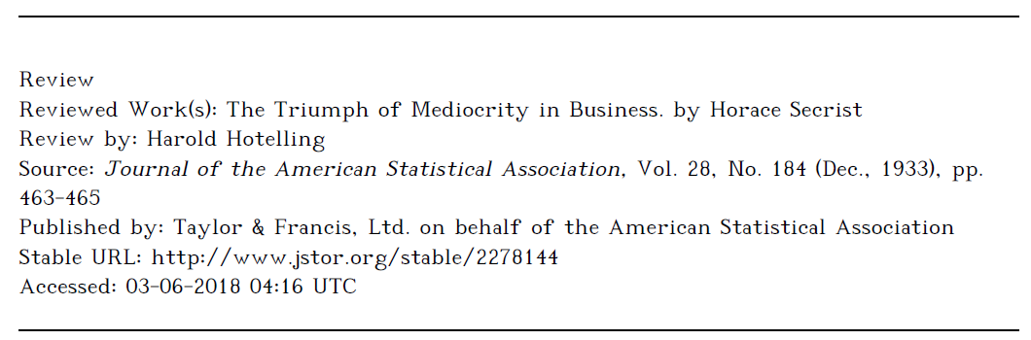
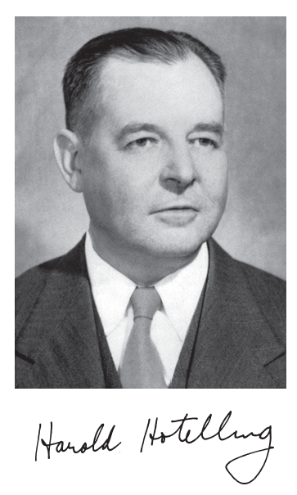
Recognition in Popular Books
From: http://www.nasonline.org/publications/biographical-memoirs/memoir-pdfs/hotelling-harold.pdf

Slide 6

Pertinence to Fad & Cult Health
“Regression in the world of Angry Chef
Let us take the patented Angry Chef health blogger template. Here it is, copied from previous posts -
‘We were living our impossibly glamorous lives as a model/PR/marketer at 100 miles an hour, eating all sort of junk and not caring what we put in our bodies. Our health was really suffering. When we started our insert name of made up diet plan here it revolutionised our lives and our friends just begged us to share our recipes with them’.”
From: http://angry-chef.com/blog/the-unstoppable-decline-of-football-in-the-east-midlands

Slide 7



Slide 8
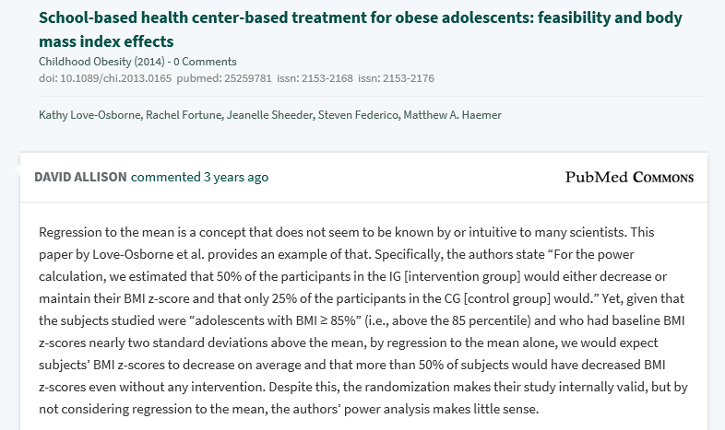
Ignoring RTM Can Lead to Mistakes in Study Design

Slide 9
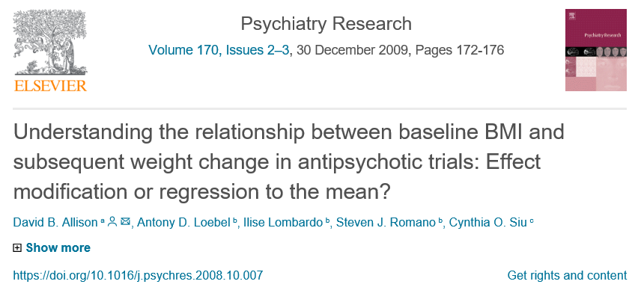
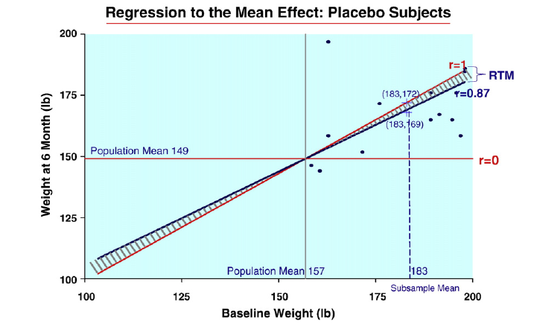
Do Antipsychotic Drugs Cause the Least Weight Gain Among those with the Highest BMIs?

Slide 10
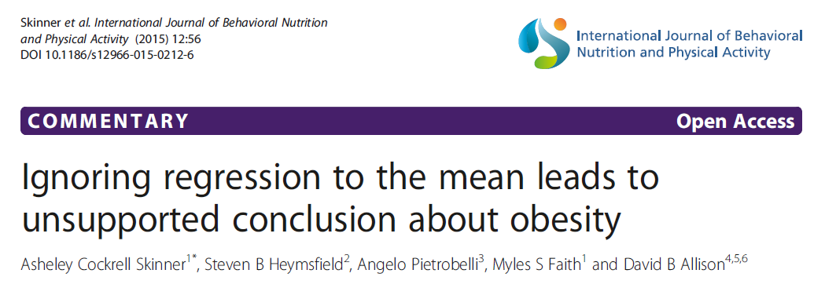
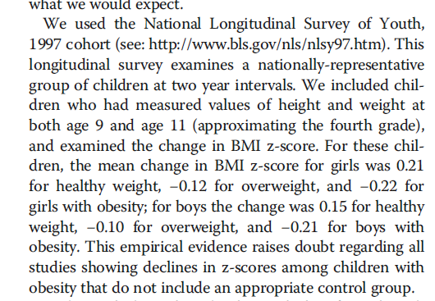
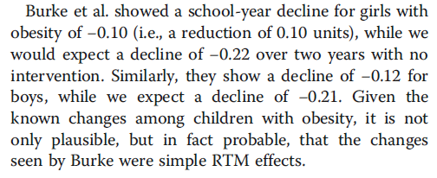

Slide 11
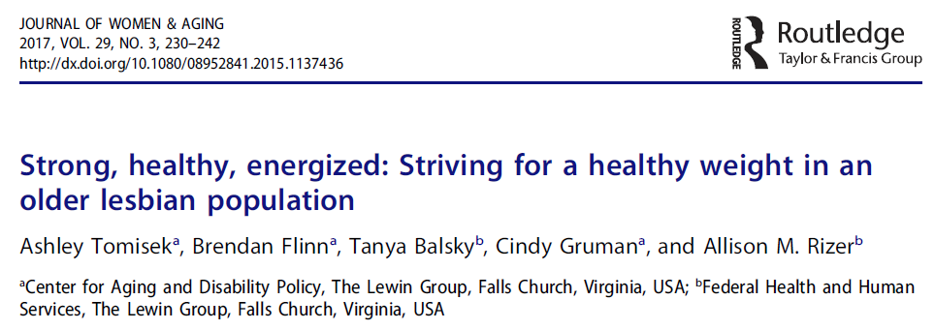
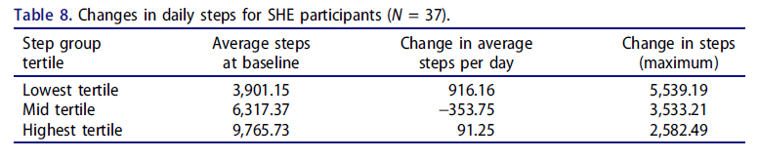
Physical Activity & Weight Loss Example
12 Week Single-Arm Lifestyle Intervention
Change in step count not reported for full sample.
Tertile analysis: lowest baseline step count, had greatest increase.
No change in weight in full sample
Tertile analysis: highest baseline body weight, had greatest weight loss.
RTM may explain findings
Concluded that “The SHE program was effective in improving health behaviors and short-term health outcomes for the target population of older lesbian and bisexual women”.
Halliday, T.M., Thomas, D.M., Siu, C.O. & Allison, D.B. (2018) Failing to Account for Regression to the Mean Results in Unjustified Conclusions: Letter Concerning Tomisek, A., Flinn, B., Balsky, T., Gruman, C.,, & Rizer, A.M. (2017) Strong, healthy, energized: Striving for a healthy weight in an older lesbian population. Journal of Women & Aging; 30(1), 10.1080/08952841.2017.1407575
Notes:
Conclusion primarily drawn from:
“…participants with the lowest one-third baseline step counts saw a marked increase in steps from beginning to end…”
“…participants who began the program with higher [body] weights lost more weight than those with lower weights.
“…participants who began the program with a larger waist circumference lost more inches over the course of the program compared to participants with smaller waist circumferences

Slide 12
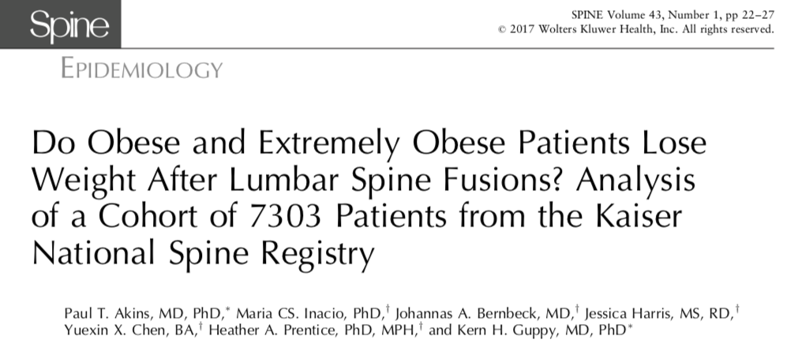
Weight Loss Example
Observed weight loss over 1 year after spinal surgery of: 21% (BMI ≥ 40), 17% (BMI 30-39), 11% (BMI < 30)
Categorized participants into groups based on extreme values of BMI at baseline
Did not compare findings to a control group
Results plausibly explainable by RTM
Concluded that “Obese and extremely obese patients are more likely to lose weight and less likely to gain weight than nonobese patients after lumbar spine fusion surgery.”
Also states “Our results provide additional information that lumbar fusion may play a beneficial role in a postsurgical weight loss plan.”
Kroeger C.M., Thomas, D.M., Sui, C. O., Allison, D.B. Overlooking Regression to the Mean Leads to Unwarranted Interpretations: Letter Concerning: ”Do Obese and Extremely Obese Patients Lose Weight after Lumbar Spine Fusions? Analysis of a Cohort of 7303 Patients from the Kaiser National Spine Registry.” Spine, 43(8):1. 2018.

Slide 13
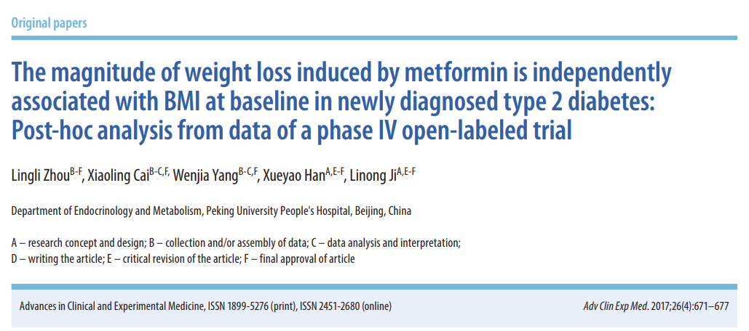
Weight Loss Example
Observed 2.4 kg weight loss over 16 weeks – but no control group
Also observed that individuals at higher body weight experienced greater weight loss (predictable by RTM)
This subgroup analysis finding is a result of RTM, not evidence of Metformin’s efficacy for weight loss
Concluded that “Metformin can lead to weight loss gradually in newly-diagnosed type 2 diabetes patients.”
Hannon, B.A., Thomas, D.M., Sui, C. O., Allison, D.B. Neglecting Regression to the Mean Continues Leads to Unwarranted Conclusions: Letter Regarding “The magnitude of weight loss induced by metformin is independently associated with BMI at baseline in newly diagnosed type 2 diabetes: Post-hoc analysis from data of a phase IV open-labeled trial” Advances in Clinical and Experimental Medicine, 2017.

Slide 14
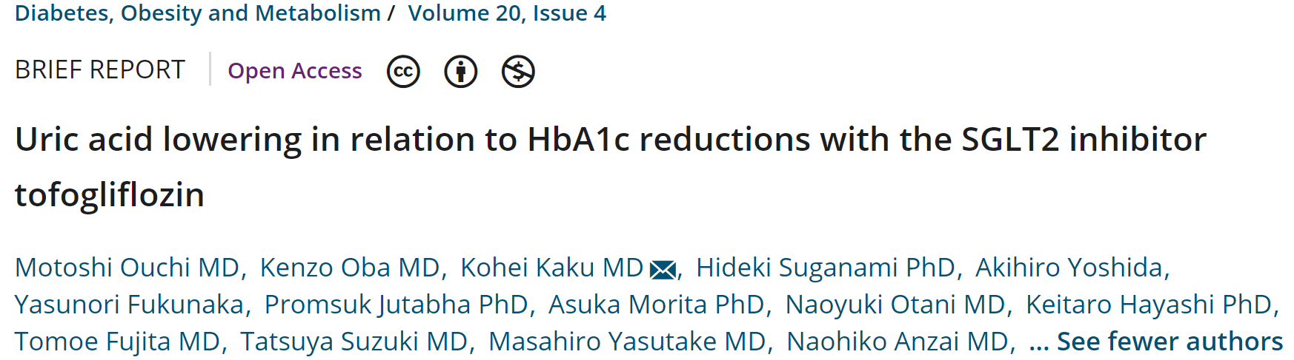
Uric Acid and HbA1c Reduction Example
Conclusions
Tofogliflozin caused greater reductions in HbA1c among individuals with higher baseline HbA1c
Serum uric acid levels decreased with SGLT-2 inhibitor treatment
RTM is a plausible explanation
Reported aggregated outcomes of four clinical trials that examined effects of SGLT-2 inhibitor tofogliflozin on HbA1c and uric acid
Divided the pooled sample into quartiles based on HbA1c
Performed pre-post comparisons of HbA1c and uric acid within quartiles without including a control group
Kahathuduwa, C. N., Thomas, D. M., Siu, C., & Allison, D. B. (2018). Unaccounted for Regression to the Mean Renders Conclusion of Article Titled “Uric acid lowering in relation to HbA1c reductions with the SGLT2 inhibitor Tofogliflozin” Unsubstantiated. Diabetes, Obesity and Metabolism; 10.1111/dom.13323

Slide 15
Fitness Training &Weight Loss Example
Significant reduction of mean percentile of BMI only within subgroups with overweight and obesity (not within the entire sample)
Conclusion
High rates of obesity could be reduced, or at least abated, if schools reinstated more frequent physical education programming
RTM is a more likely explanation
Non-experimental pre-post design
No reference (control) group
Pre-post comparisons of BMI percentiles
Of the entire sample
Within subgroups defined based on baseline BMI percentile
Kahathuduwa, C. N., Thomas, D. M., Siu, C., & Allison, D. B. (2018). Due to Regression to the Mean, the Published Conclusion of “We Run This City: Impact of a Community–School Fitness Program on Obesity, Health, and Fitness” Regarding Effects on BMI Cannot Be Substantiated. Submitted to Preventing Chronic Disease.

Slide 16
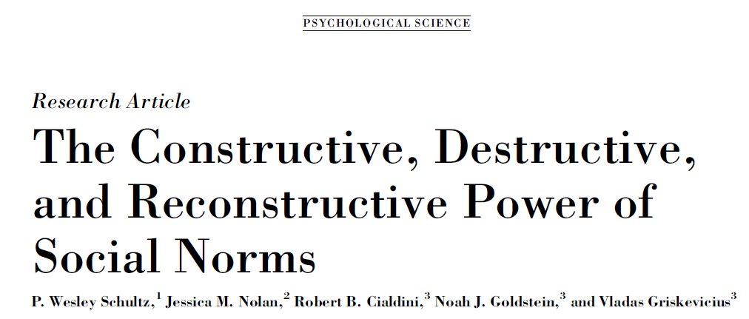
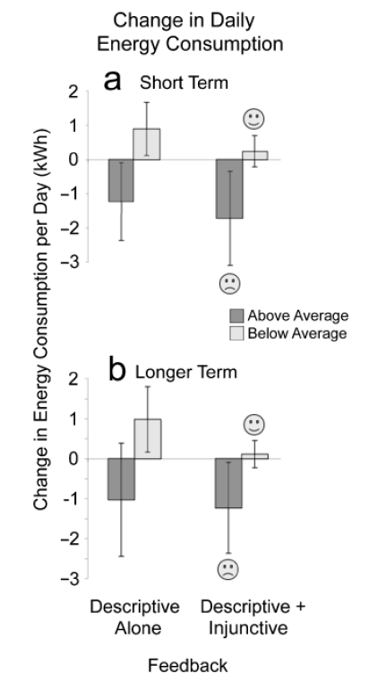
This Issue Also Arises in Other Areas of Research
“For households that consumed more than average during the baseline period, the descriptive-norm-only feedback produced a significant decrease in energy consumption…”
“In contrast, for households that were below the mean on baseline energy consumption, the descriptive-norm-only message produced an increase in energy consumption…”

Slide 17
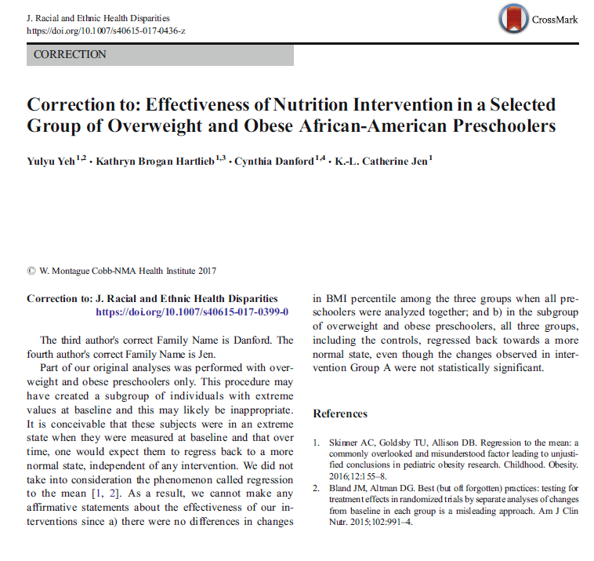
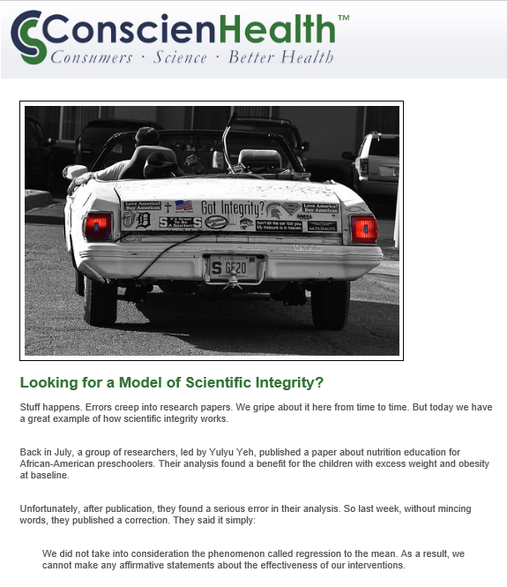
There Are Those With The Integrity to Acknowledge Errors

Slide 18
Testing in the Context of RTM: Different Hypotheses and Tests Often Conflated.
Alternative Hypothesis | Test | Reference(s)
H_{1,A}: There is an association of baseline values of the variable (e.g., BMI) with change in the variable. | Ordinary tests of correlation and association.
H_{1,B}: There is a trend toward ‘mediocrity’, i.e., the distribution of the variable has, on average, smaller deviations from the mean at the second time point than it did at the first. | Tests of reduction in variance. | Hotelling, H. (1933). JASA. Kelly, C., Price, T. D. (2005). The American Naturalist.
H_{1,C}: There is a decrease [increase] in the mean of a variable among subjects selected to be (on average) above [below] the mean of that variable that cannot be explained solely by RTM under the assumption of a bivariate normal distribution. | Test of whether the parameter estimate γ in the model Y₁-μ = γρ(Y₀-μ) + ε is less than 1.0. | Senn, S.J., Brown, R. A., & James, K. E. (1985). Biometrics.
H_{1,D}: An intervention had different effects on change in a variable as a function of the baseline values of that variable. | Tests of interaction between baseline values and treatment with changes as outcomes. | Allison, D. B. et al. (2009). Psychiatry Research. George, B. et al. (2016). Obesity.

Slide 19
Decision Tree for Assessing Whether Regression to the Mean is Leading to Unsubstantiated Conclusions About Intervention Effects in Studies in Which Change in one or More Variables are the Outcomes♣
Were subjects receiving the intervention being studied and/or sampled in such a way that those on one side of the mean were overrepresented (e.g., only including subjects with BMIs above some level)?
No
Yes
Are analyses being conducted and/or conclusions being drawn on subsets of the intervention group defined by baseline distribution of the outcome variables?
Yes
Was a control group (ideally randomized) included that was sampled in roughly the same way as the intervention group and had roughly the same baseline distribution of the outcome variables?
No
Yes
Are conclusions being drawn by testing for the significance in change from baseline in the intervention group (or subsets of the intervention group)?
Are conclusions being drawn as a function of a significance test of the differences in outcomes between the group receiving the intervention and the control group (or subsets thereof)?
No
Yes
No
Yes
RTM is not obviously a problem.
No
Unclear.
Are conclusions being drawn by conducting a significance test of change from baseline in the intervention group and a separate significance test of change from baseline in the control group (or subsets thereof) and declaring an effect if the result is significant in the intervention group, but not in the control group?
RTM is not obviously a problem.
RTM is a problem and could be creating spurious conclusions.
Authors are making the so-called DINS error (George et al., 2016*) which could be exacerbated by RTM.
Yes
♣ Prepared by David B. Allison, Indiana University-Bloomington
*https://www.ncbi.nlm.nih.gov/pubmed/27028280
Unclear.
No

Slide 20
Some References
Allison, D. B., Loebel, A. D., Lombardo, I., Romano, S. J., Siu, C. O. (2009). Understanding the relationship between baseline BMI and subsequent weight change in antipsychotic trials: Effect modification or regression to the mean? Psychiatry Research, Dec 30;170(2-3):172-6.
Bland J M, Altman D G. Statistic Notes: Regression towards the mean BMJ 1994; 308 :1499
George, B. J., Beasley, T. M., Brown, A. W., Dawson, J., Dimova, R., Divers, J., Goldsby, T. U., Heo, M., Kaiser, K. A., Keith, S., Kim, M. Y., Li, P., Mehta, T., Oakes, J. M., Skinner, A., Stuart, E., & Allison, D. B. (2016). Common scientific and statistical errors in obesity research. Obesity, Apr;24(4):781-90. doi: 10.1002/oby.21449.
Halliday, T.M., Thomas, D.M., Siu, C.O. & Allison, D.B. (2017) Failing to Account for Regression to the Mean Results in Unjustified Conclusions: Letter Concerning Tomisek, A., Flinn, B., Balsky, T., Gruman, C.,, & Rizer, A.M. (2017) Strong, healthy, energized: Striving for a healthy weight in an older lesbian population. Journal of Women & Aging; 30(1), 10.1080/08952841.2017.1407575
Hannon, B., Thomas, D. M., Siu, C., O., & Allison, D. B. (in press). Neglecting Regression to the Mean Continues to Lead to Unwarranted Conclusions: Letter Regarding “The magnitude of weight loss induced by metformin is independently associated with BMI at baseline in newly diagnosed type 2 diabetes: Post-hoc analysis from data of a phase IV open-labeled trial.” Advances in Clinical and Experimental Medicine.
Kahathuduwa, C. N., Thomas, D. M., Siu, C. & Allison, D. B.. (in preparation). Due to Regression to the Mean, the Published Conclusion of “We Run This City: Impact of a Community–School Fitness Program on Obesity, Health, and Fitness” Regarding Effects on BMI Cannot Be Substantiated. Prev Chronic Dis.
Kahathuduwa, C. N., Thomas, D. M., Siu, C., & Allison, D. B. (2018). Unaccounted for Regression to the Mean Renders Conclusion of Article Titled “Uric acid lowering in relation to HbA1c reductions with the SGLT2 inhibitor Tofogliflozin” Unsubstantiated. Diabetes, Obesity and Metabolism, 2018 Apr 16. doi: 10.1111/dom.13323.
Kroeger, C.M., Thomas, D., Siu, C.S., & Allison, D.B. (2018). Overlooking regression to the mean leads to unwarranted interpretations: Letter concerning, "Do obese and extremely obese patients lose weight after lumbar spine fusions? Analysis of a cohort of 7303 patients from the Kaiser national spine registry". Spine April 2018. doi: 10.1097/BRS.0000000000002564
Skinner, A. C., Goldsby, T. U., & Allison, D. B. (2016). Regression to the Mean: A Commonly Overlooked and Misunderstood Factor Leading to Unjustified Conclusions in Pediatric Obesity Research. Childhood Obesity, Apr;12(2):155-8. doi: 10.1089/chi.2015.0222.
Skinner, A. C., Heymsfield, S. B., Pietrobelli, A., Faith, M. S., Allison, D. B. (2015). Ignoring Regression to the Mean Leads to Unsupported Conclusion about Obesity. [Letter]. Submitted to International Journal of Behavioral Nutrition and Physical Activity. http://www.ijbnpa.org/content/12/1/56.
Smith, D. L., Thomas, D., M., Siu, C. O., Verhulst, S., & Allison, D. B. (2018) Regression to the Mean, Apparent Data Errors, and Biologically Extraordinary Results: Letter Regarding “Changes in telomere length 3–5 years after gastric bypass surgery”. International Journal of Obesity, Apr;42(4):949-950. doi: 10.1038/ijo.2017.298
Yeh, Y., Hartlieb, K.B., Danford, C. et al. J. Correction to: Effectiveness of Nutrition Intervention in a Selected Group of Overweight and Obese African-American Preschoolers. Racial and Ethnic Health Disparities (2017). https://doi.org/10.1007/s40615-017-0436-z. See also: http://conscienhealth.org/2017/10/looking-model-scientific-integrity/

Slide 21
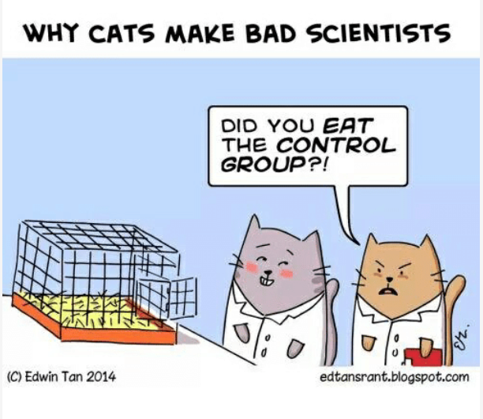
From: https://me.me/i/why-cats-make-bad-scientists-did-you-eat-the-control-1696661

Slide 22



“…let us take this path through the woods…”
~ Jean-Jacques Rousseau
Courtesy of Inside IU.
Courtesy of IU Archives.
Notes:
22

